Slide 1


Ian Barker
Developer Advocate

Slide 2
There is also an example which uses Delphi...

Slide 3
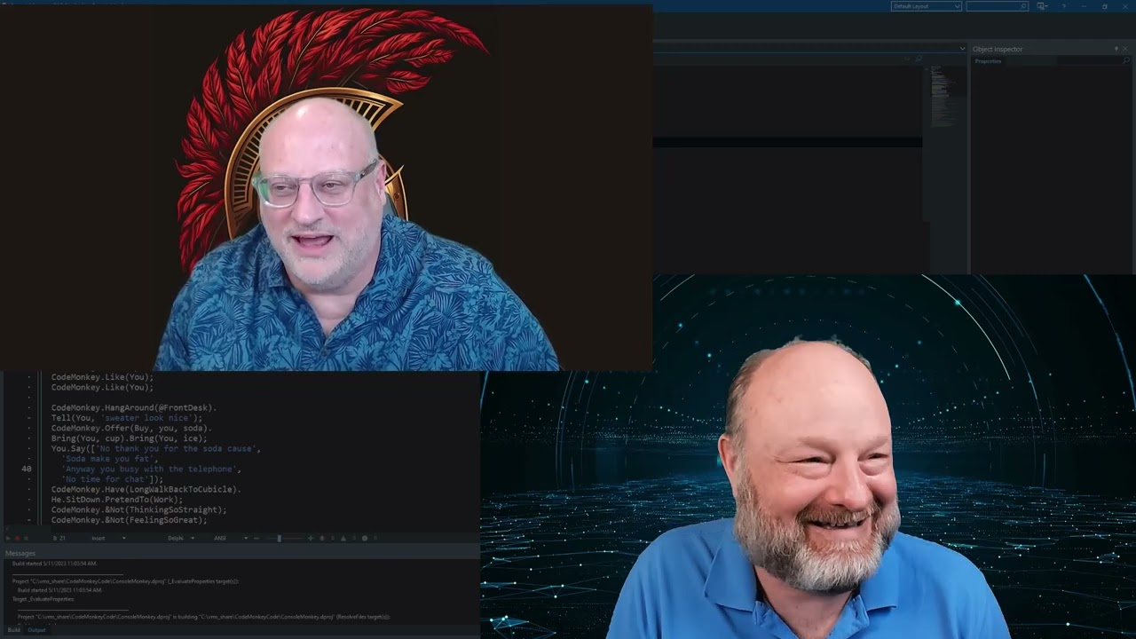
May 11 2023..

Slide 4
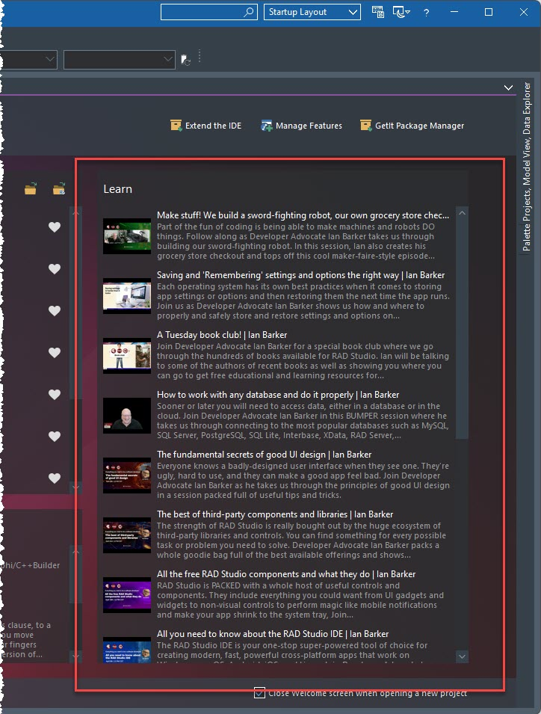

Emphasizing learning in the IDE
Automatically updates with new webinar content
Snack-sized ‘influencer style’ webinars designed to create a sense of community
Single subject, step-by-step, graphically rich, easy to follow
Aimed at the person who opens the IDE for the first time and says “what can I do with RAD Studio?”

Slide 5
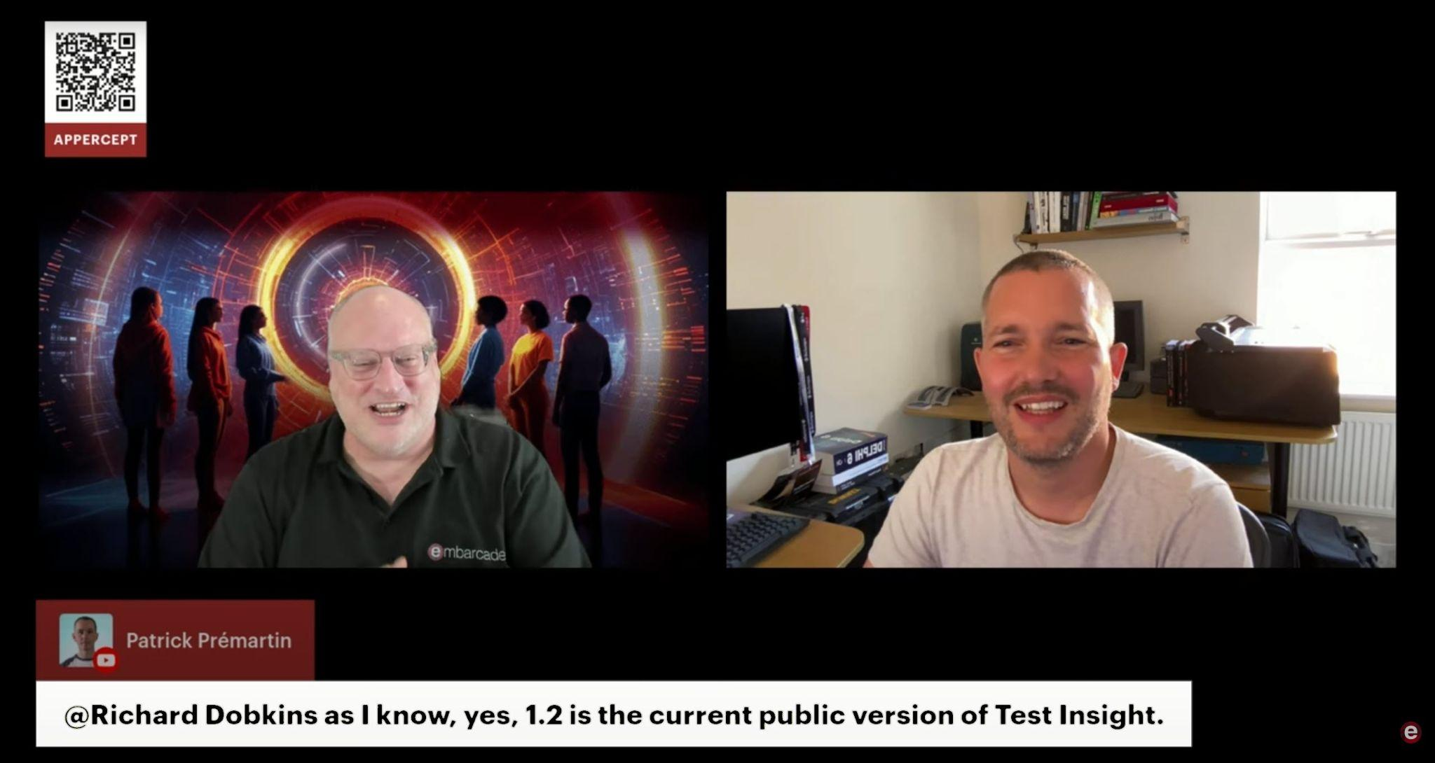
Modernizing and expanding our outreach
Overhauled our organic content to make it approachable, engaging, and informative
Making use of the ‘social graph’ to reach more net new viewers and potential customers

Slide 6
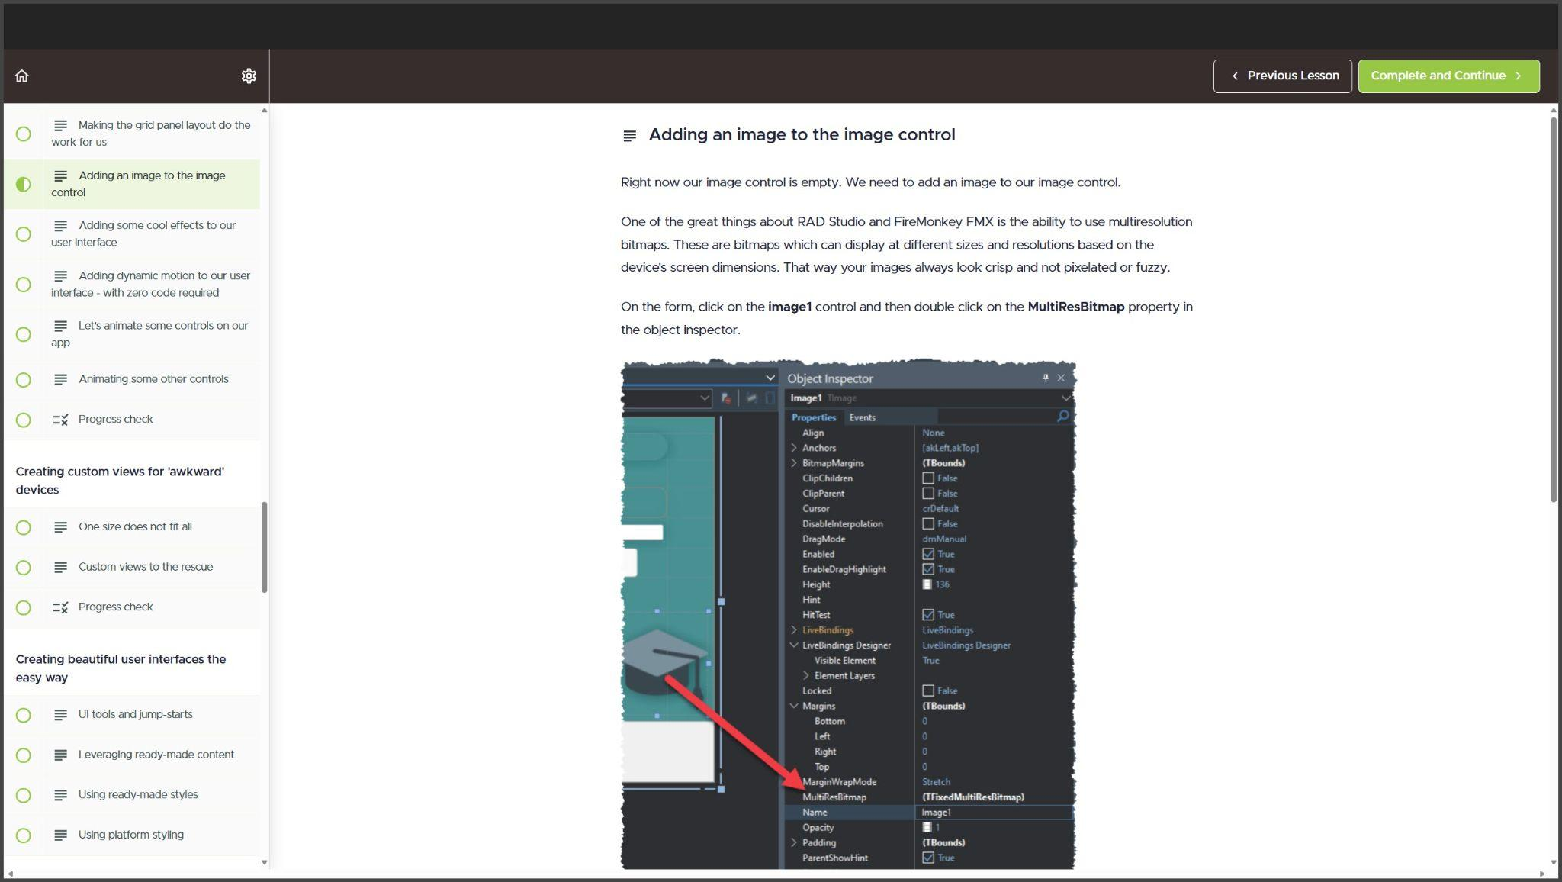
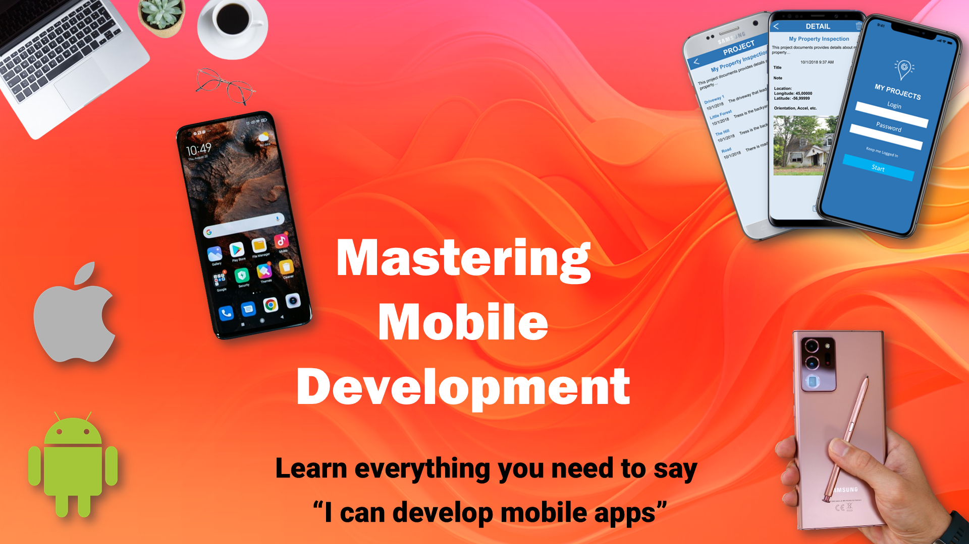
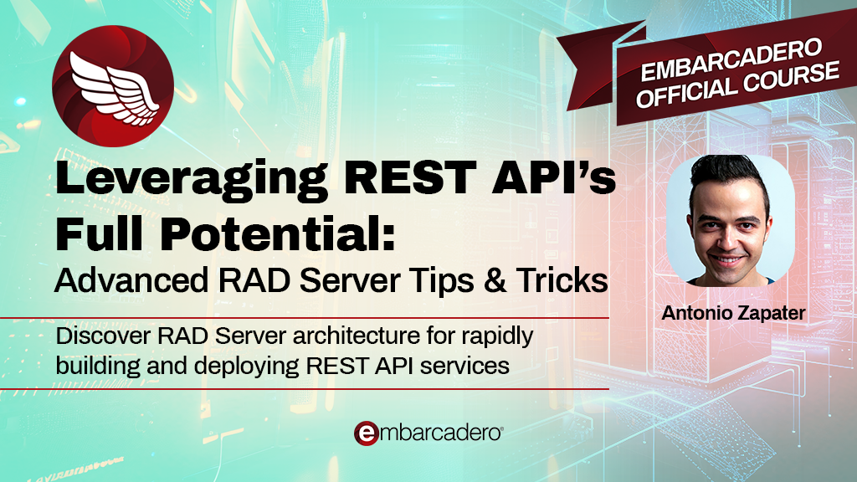
Learning resources
Producing our own ‘official’ educational content available free as an incentive for sales and upgrades
On embarcaderoacademy.com with more courses and content planned

Slide 7
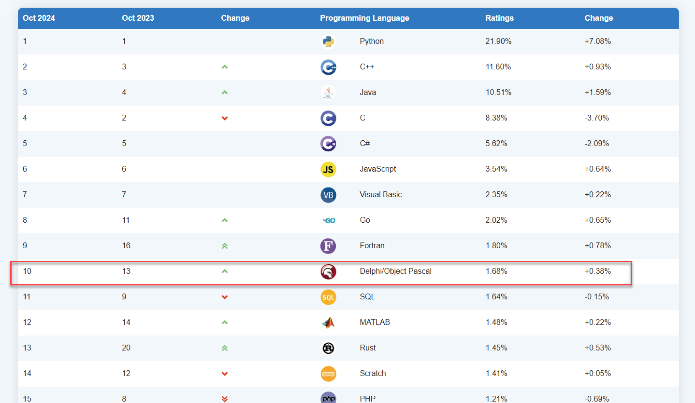
Is it working?
Obviously, sales and retention are the key evergreen metric
But 15 months ago we were number 17🥹
Now, we are in the top 10 🥳
It means nothing at all, and it means everything
Notes:
This is the highest position in TWENTY THREE YEARS (2001 was the last time we were this high in the index)

Slide 8
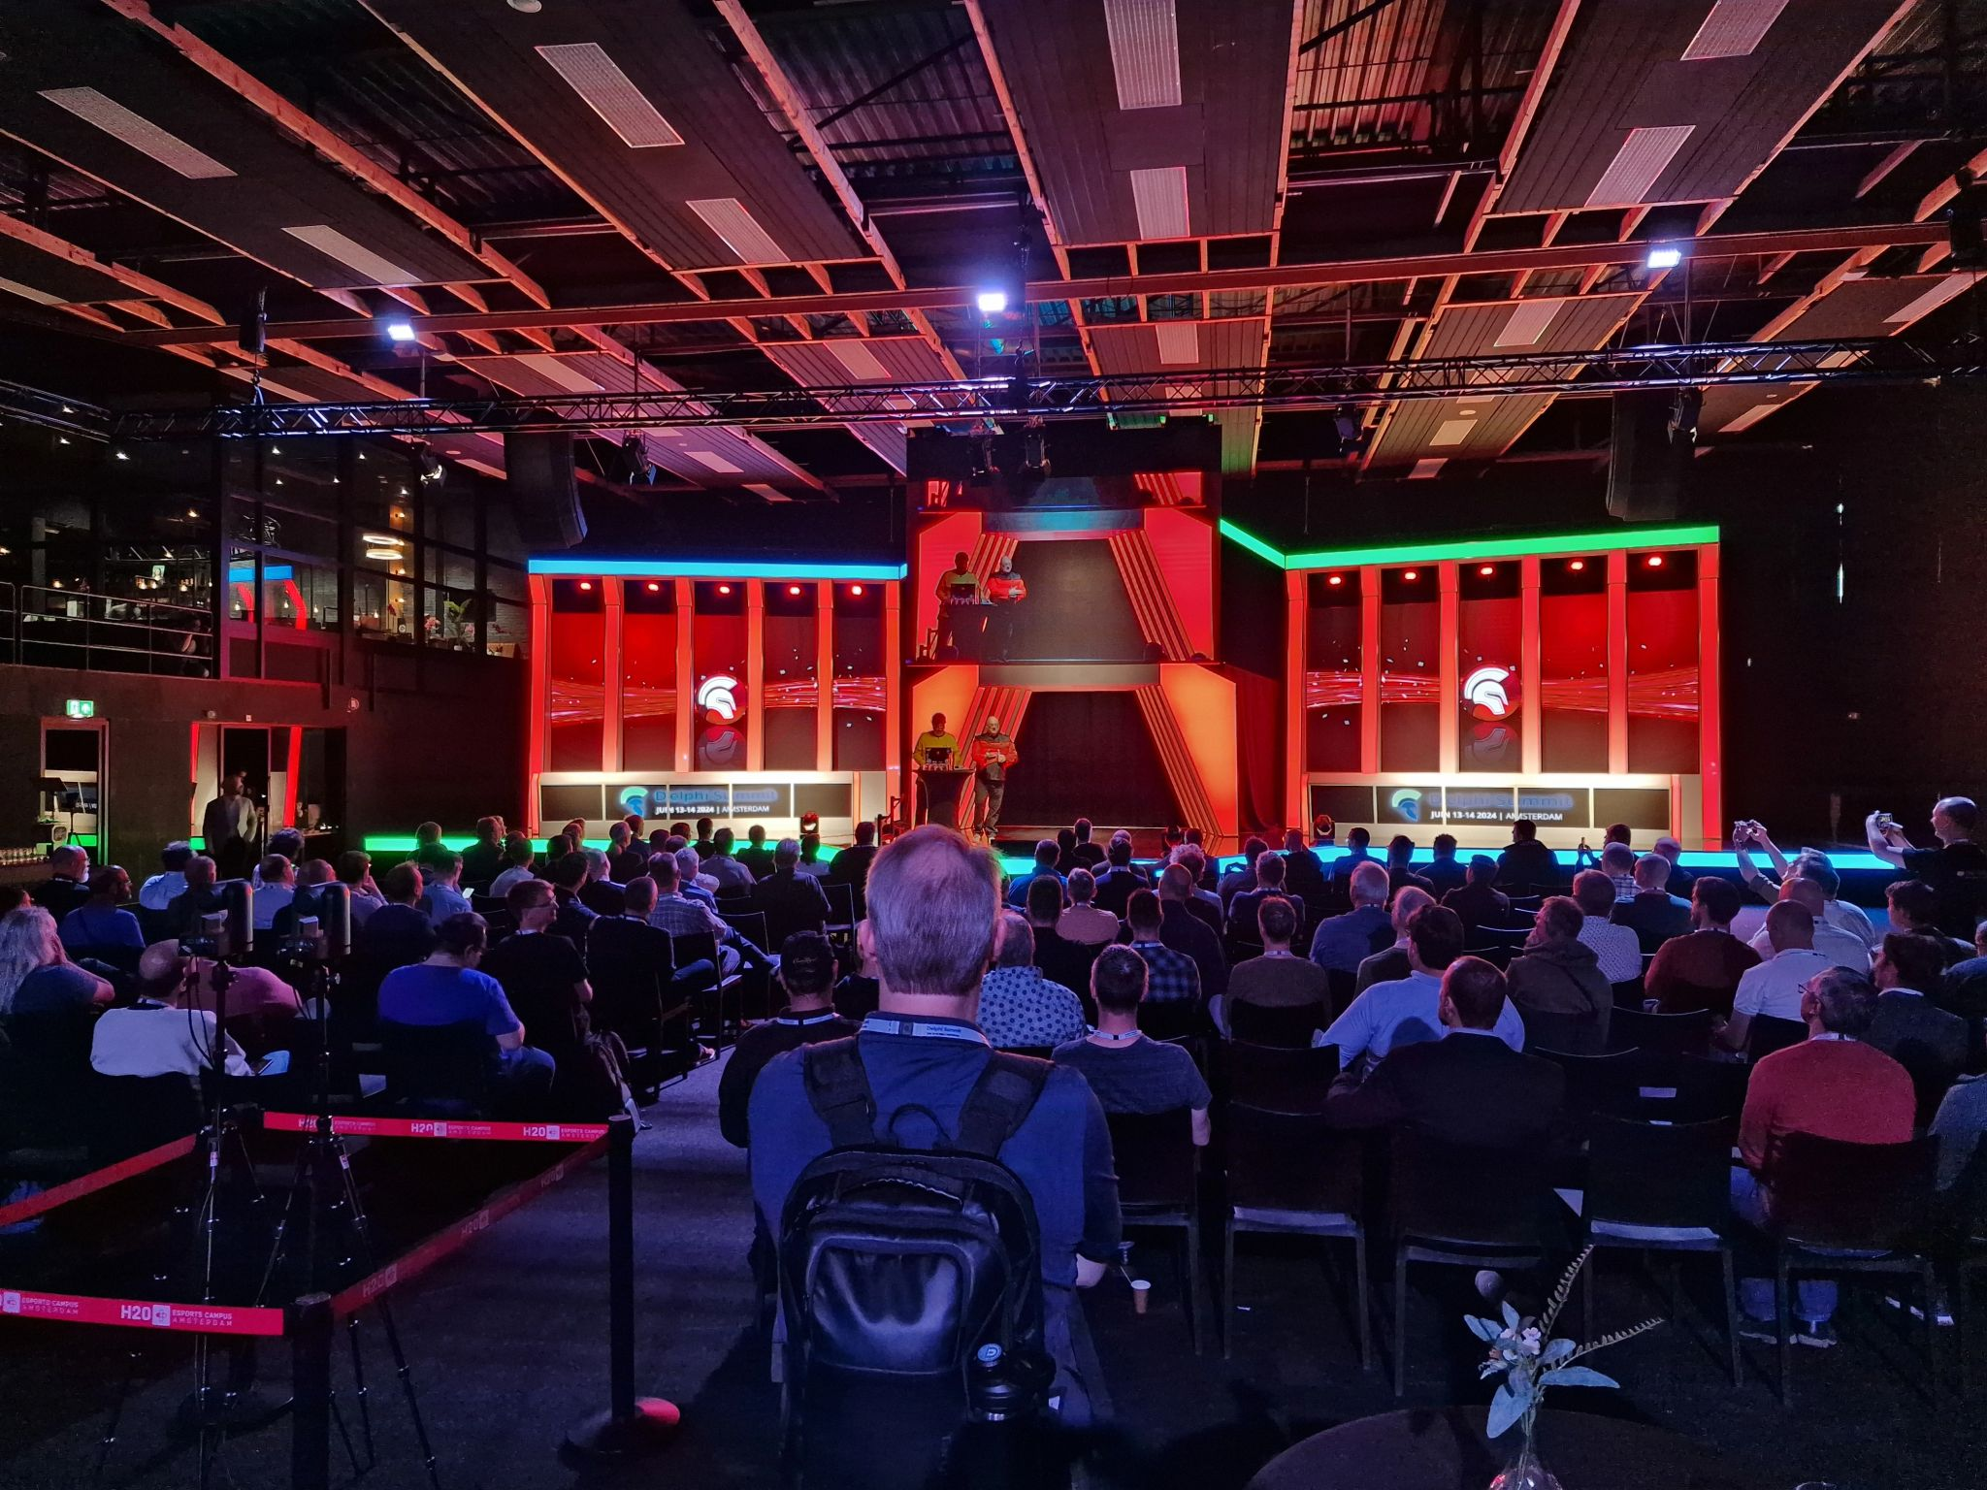
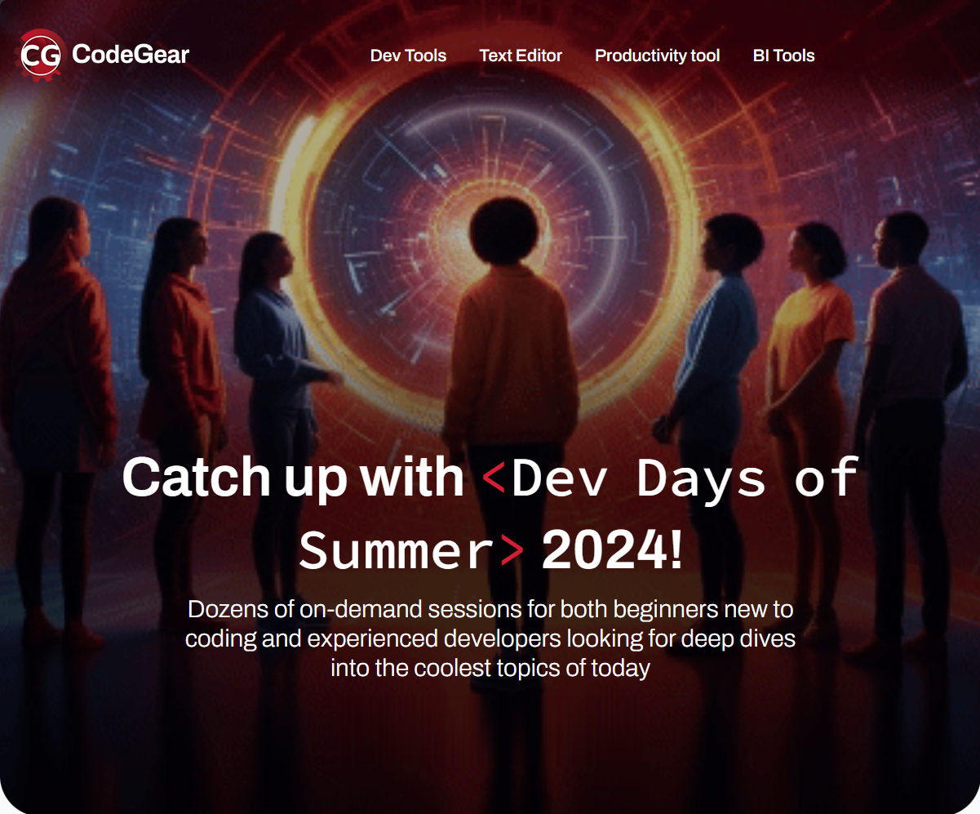
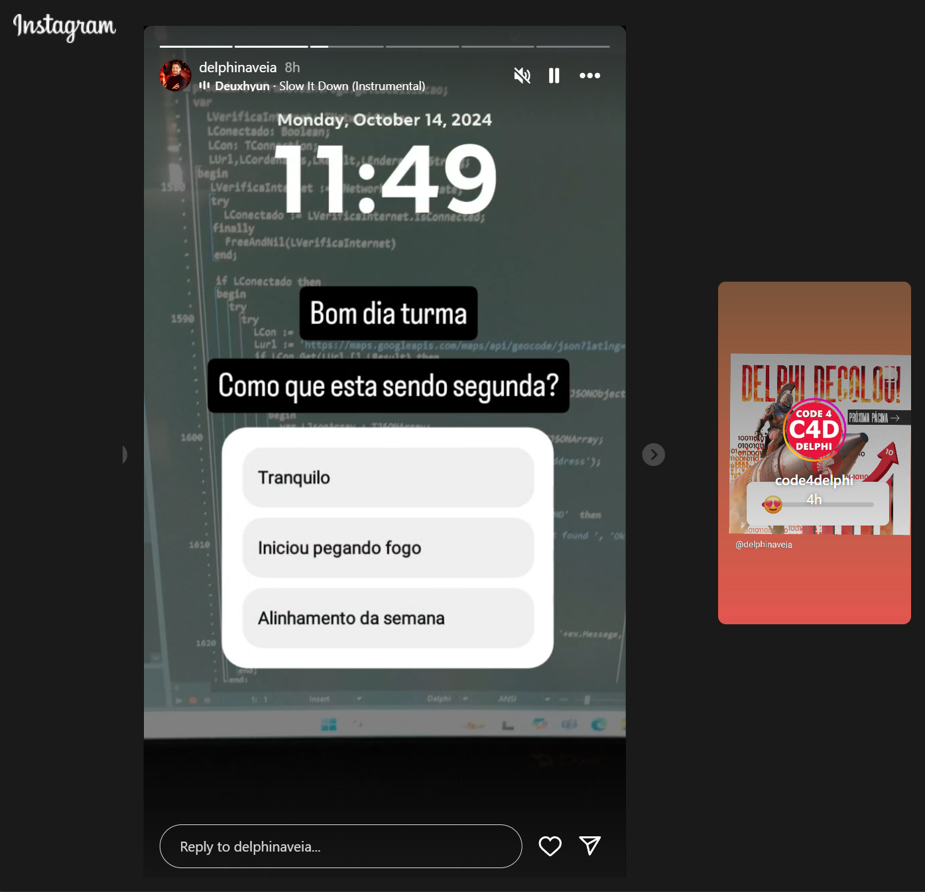
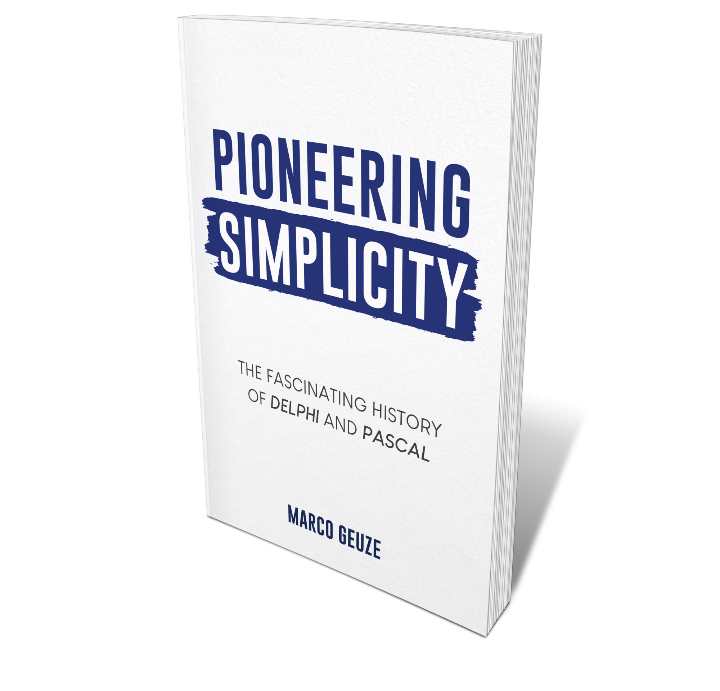
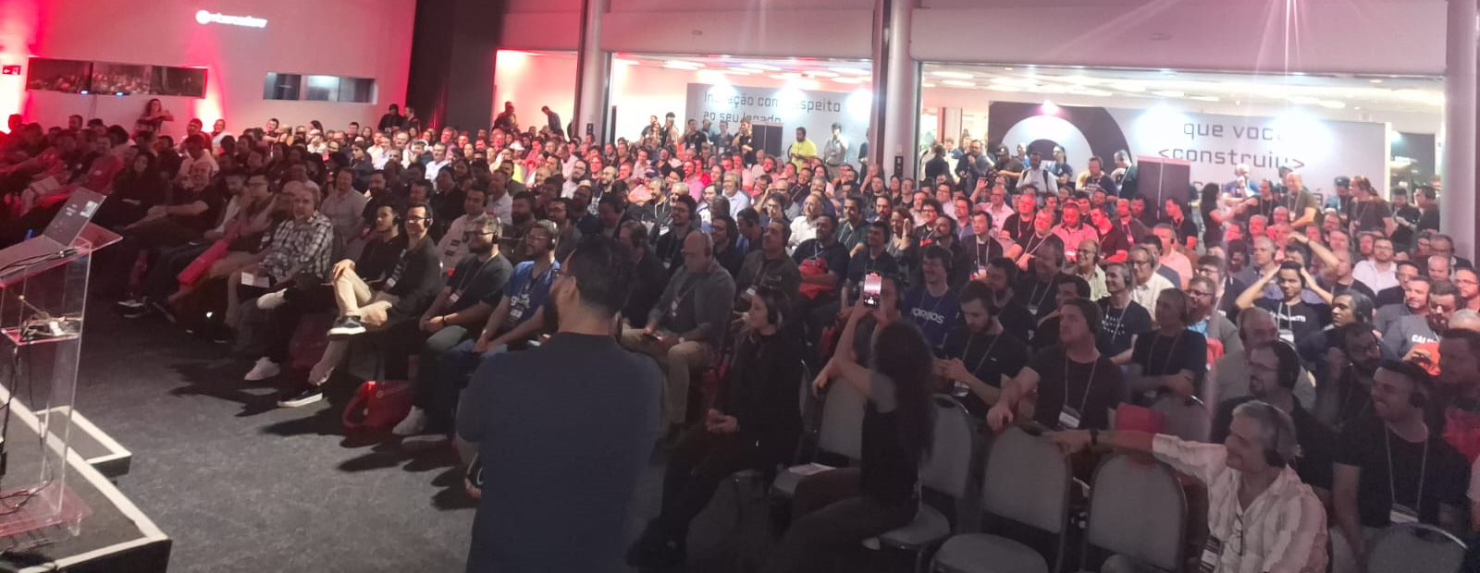
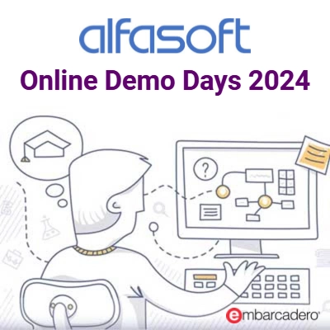
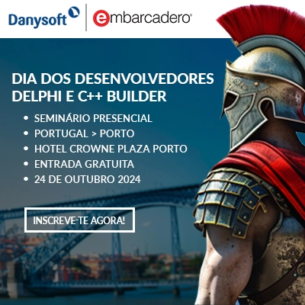
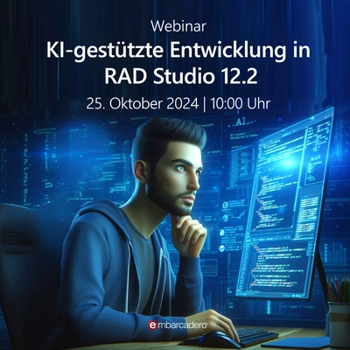

Positivity is picking up

Slide 9
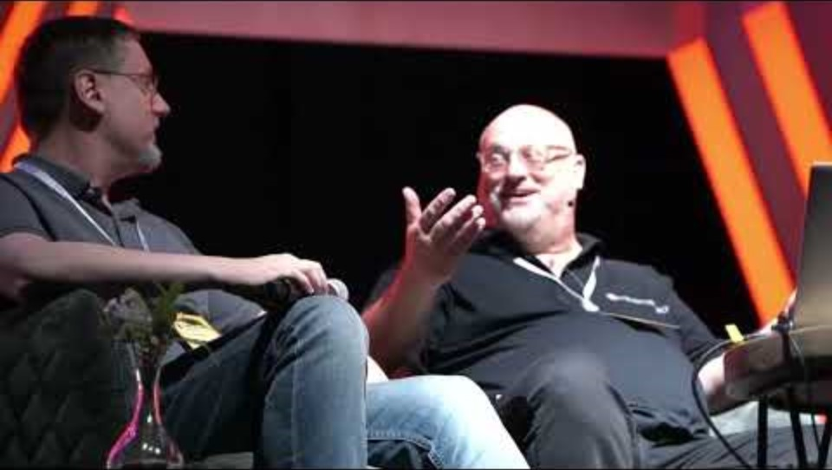
Selected events: The Delphi Summit held in Amsterdam, The Netherlands
Notes:
This is the highest position in TWENTY THREE YEARS (2001 was the last time we were this high in the index)

Slide 10
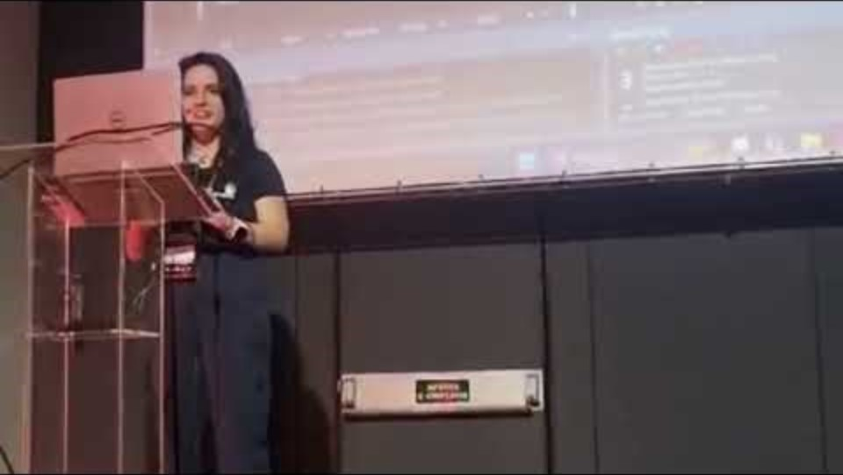
Selected events: Embarcadero Conference 2024 held in São Paulo, Brazil
Notes:
This is the highest position in TWENTY THREE YEARS (2001 was the last time we were this high in the index)

Slide 11
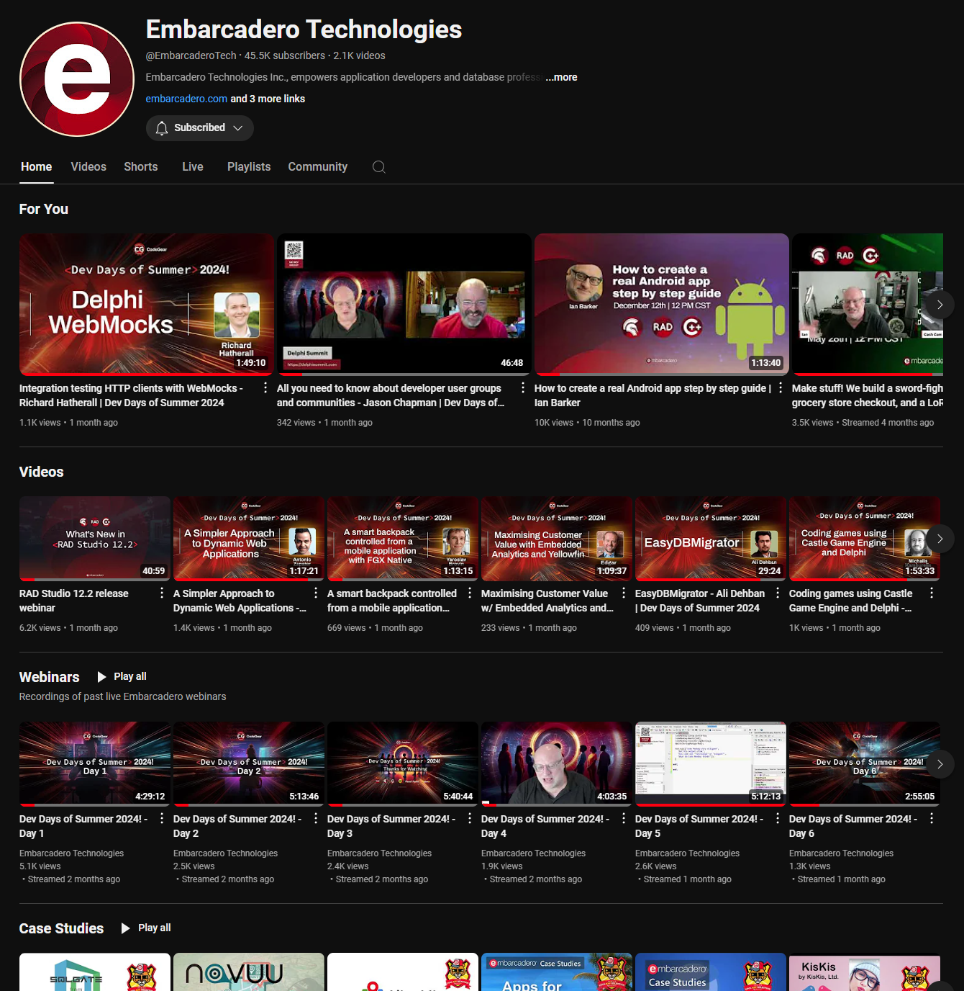
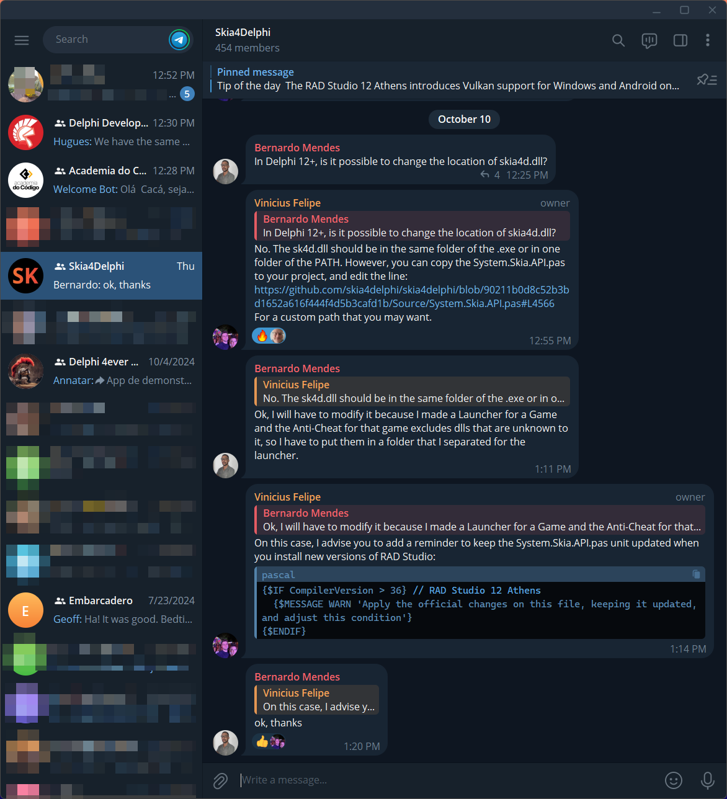
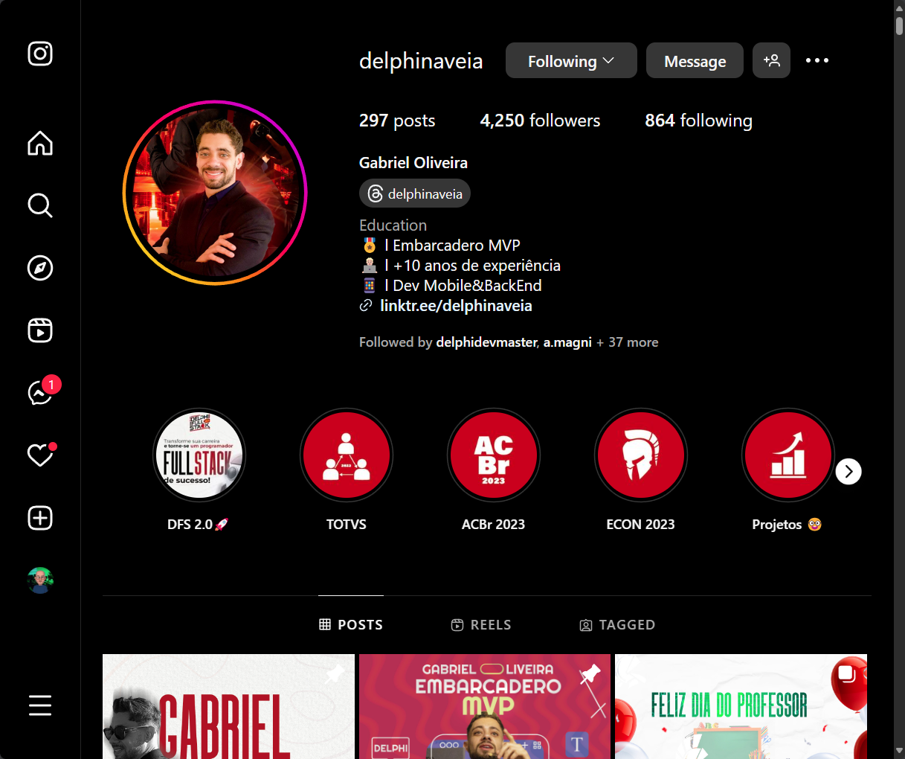


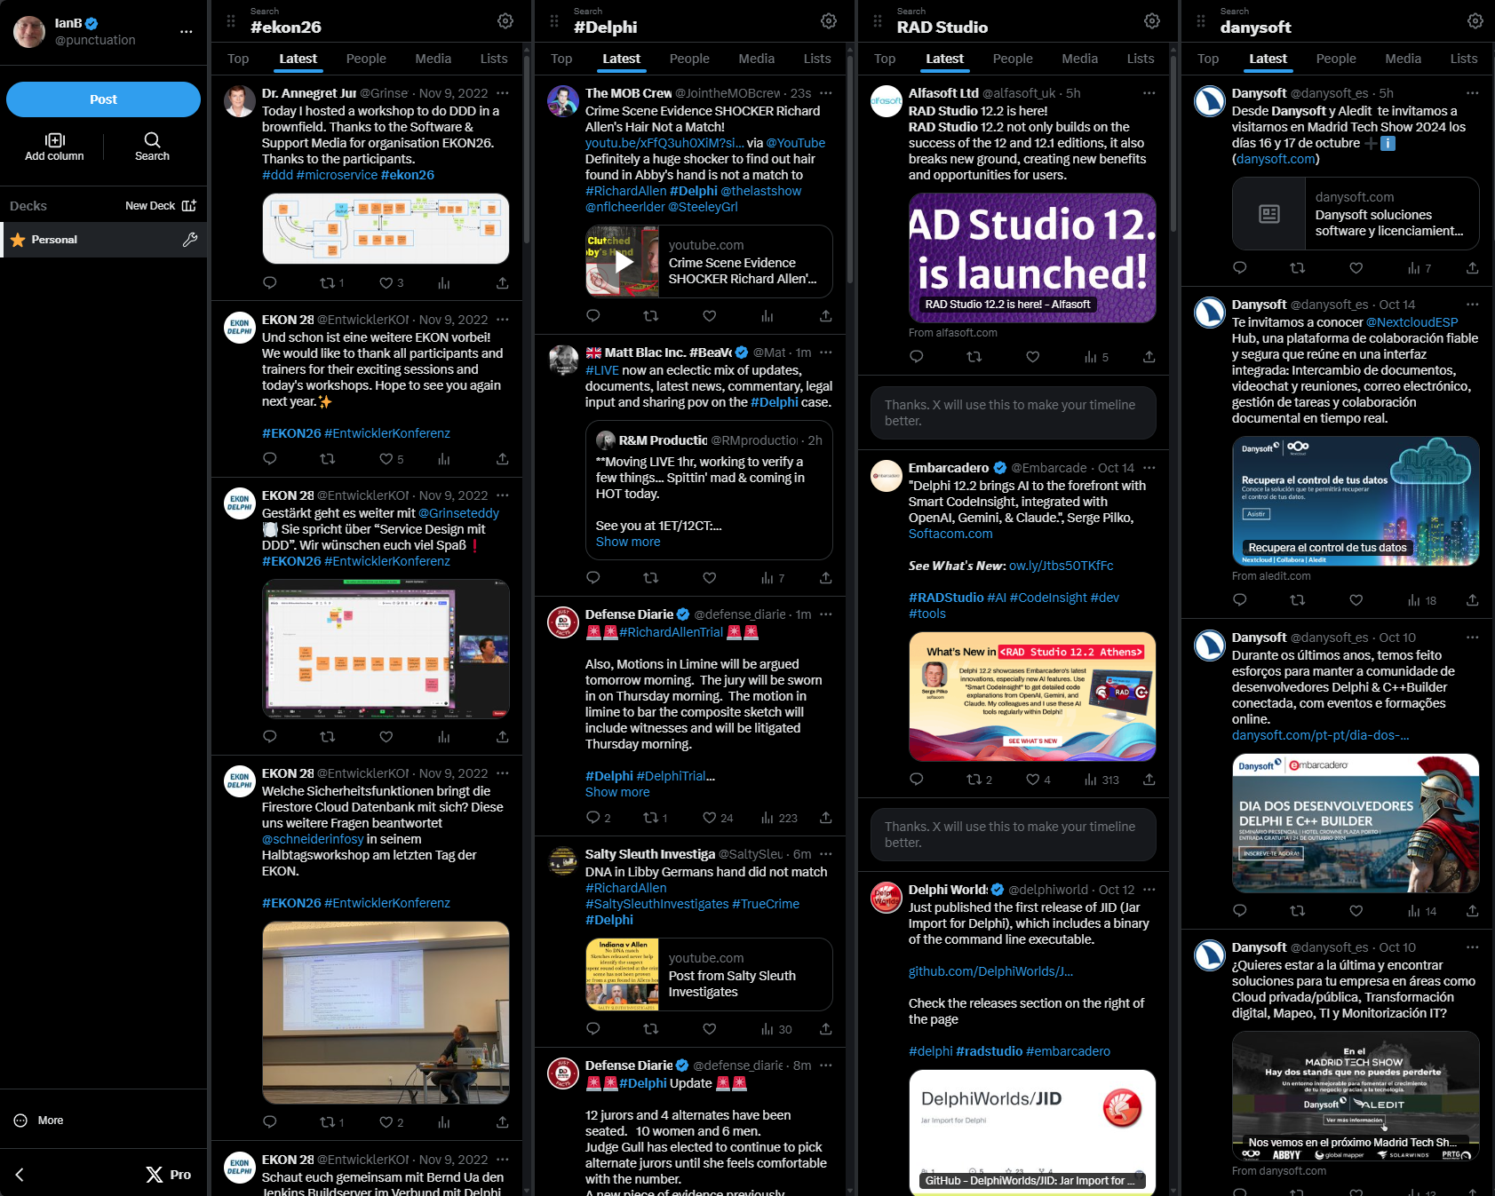
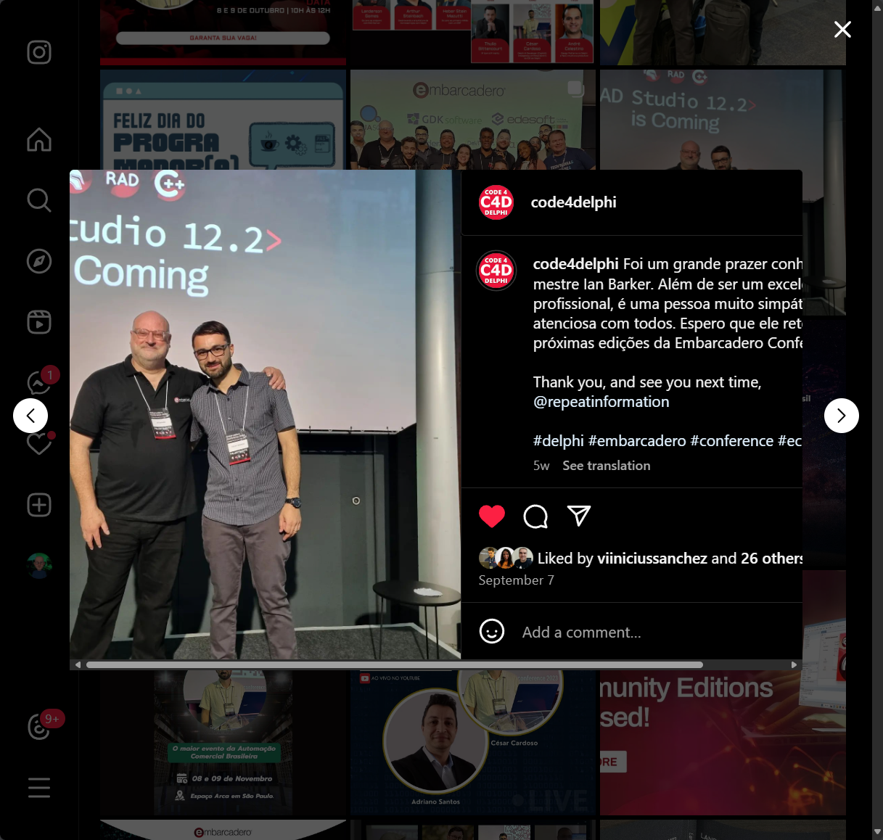



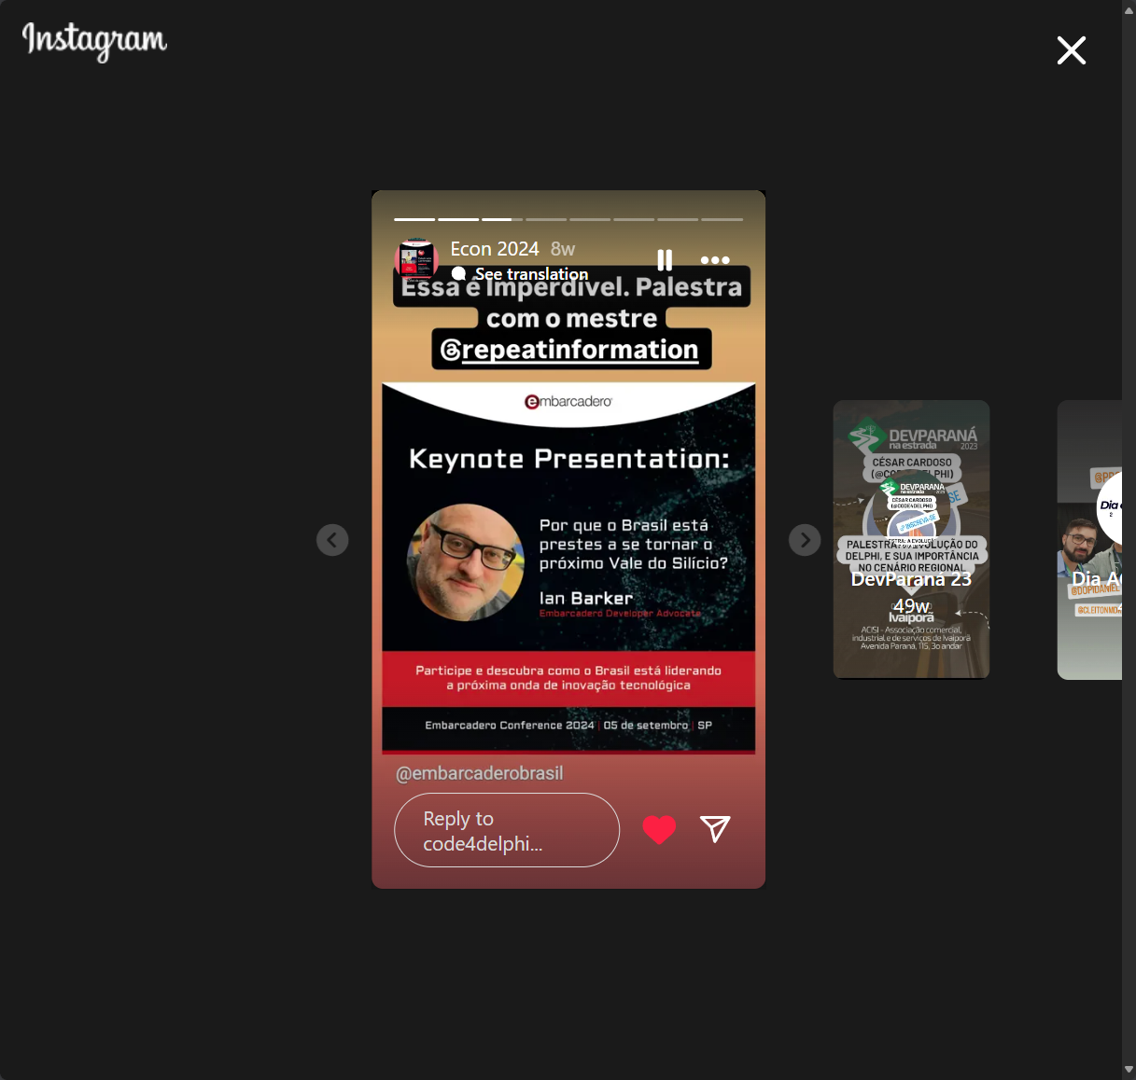

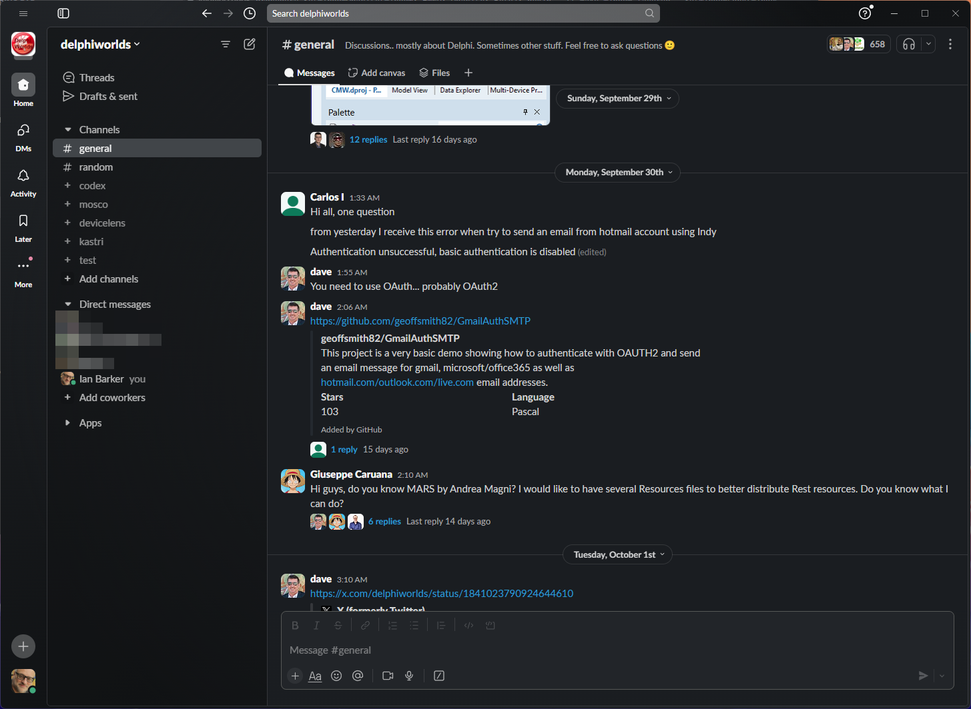

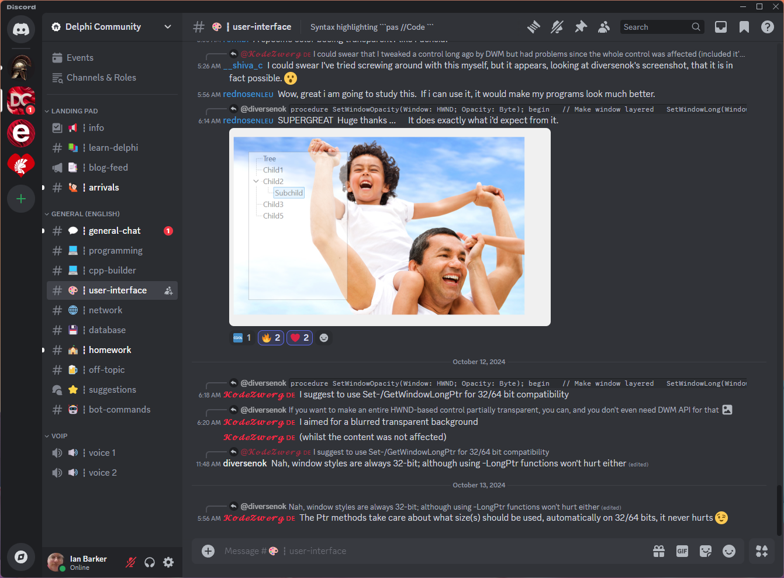
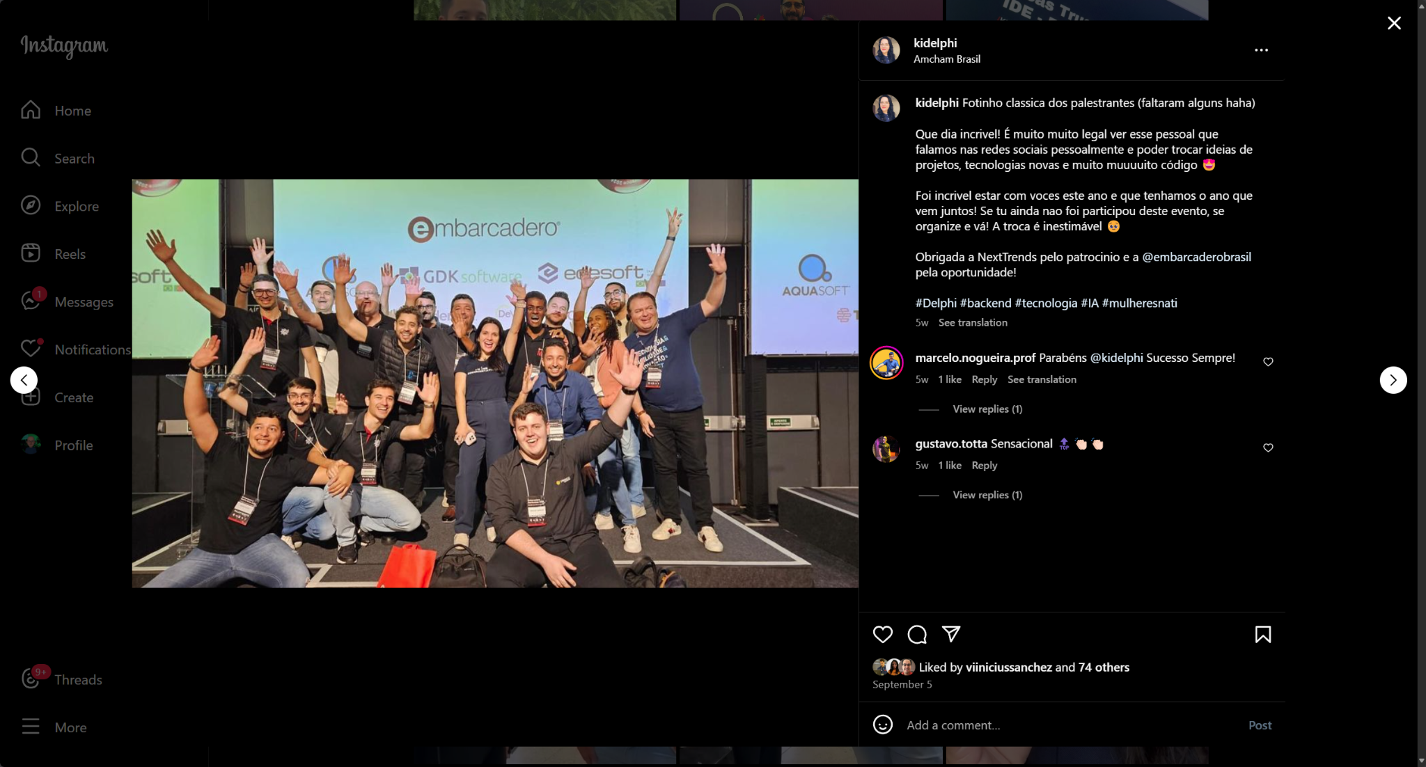




Community outreach and engagement
Notes:
This is the highest position in TWENTY THREE YEARS (2001 was the last time we were this high in the index)

Slide 12
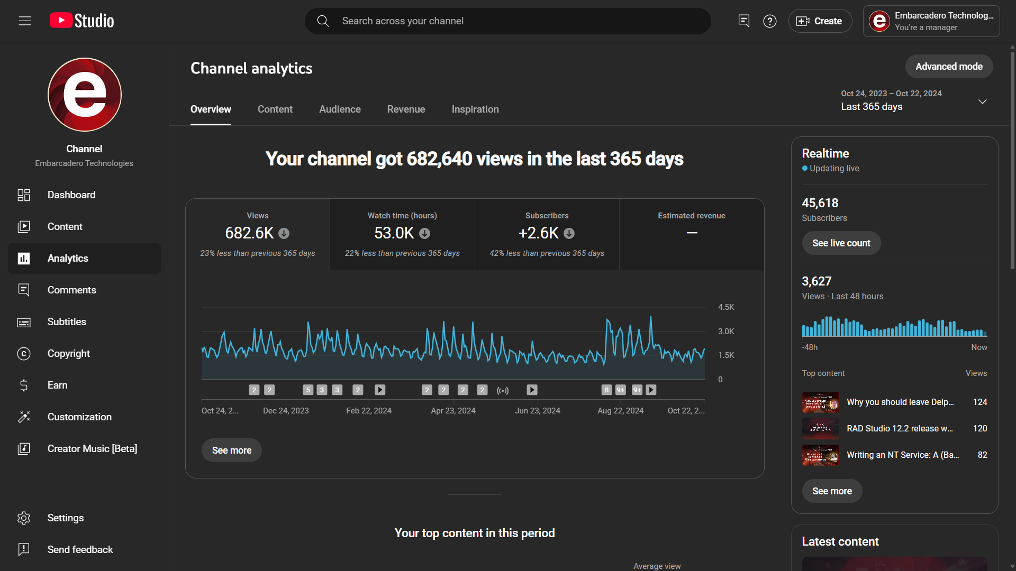
YouTube
Notes:
This is the highest position in TWENTY THREE YEARS (2001 was the last time we were this high in the index)

Slide 13
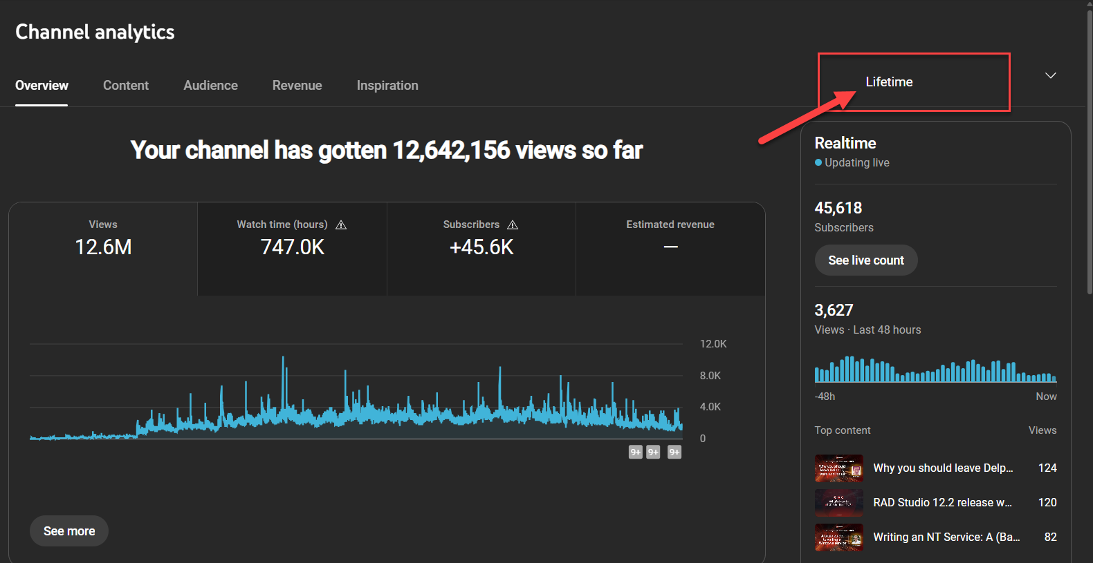
YouTube
Notes:
This is the highest position in TWENTY THREE YEARS (2001 was the last time we were this high in the index)

Slide 14


Some plans
There is also an example which uses Delphi
Get this book which shows you how to be a software developer
Here it is in RAD Studio
Delphi on the curriculum, Delphi on the guest list
Joint events for
More written content, all the time
On this week’s webinar
Notes:
APIs, SDKs, open source projects, AI resources - make them have Delphi examples, book is obvious, here it is in RAD Studio - emulate/clone popular apps to show it can be done, Delphi in education, webinars - two per week, starting next week

Slide 15
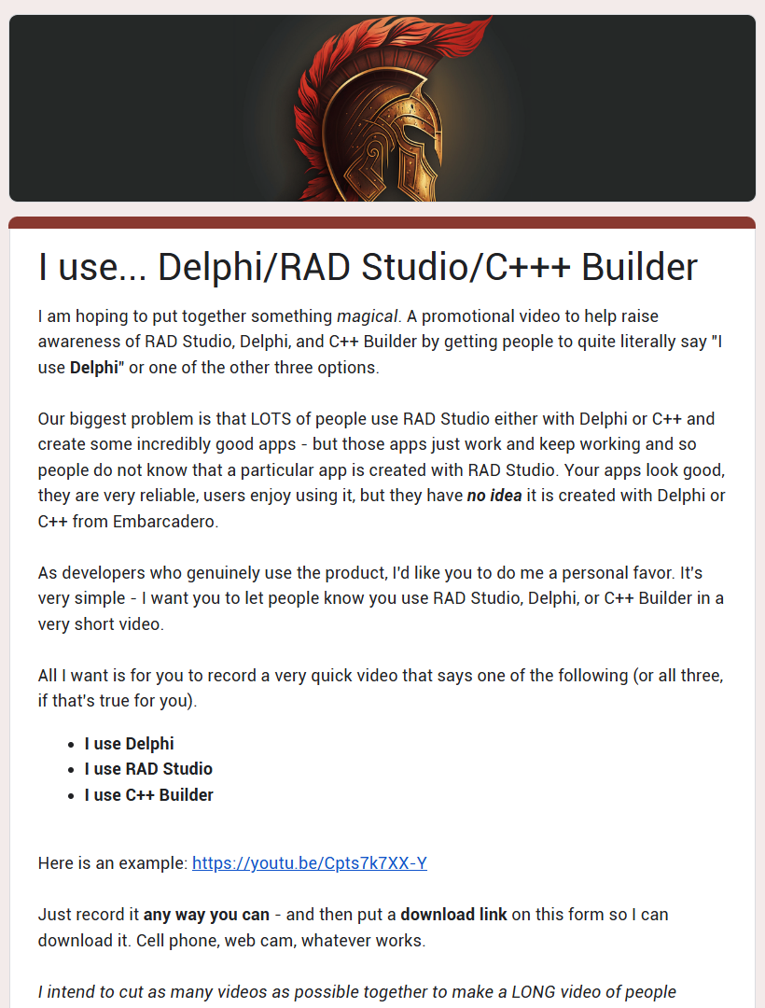
Help me!
tinyurl.com/iusedelphi
Notes:
APIs, SDKs, open source projects, AI resources - make them have Delphi examples, book is obvious, here it is in RAD Studio - emulate/clone popular apps to show it can be done, Delphi in education, webinars - two per week, starting next week

Slide 16
Ian Barker
Developer Advocate

